Slide 1

Team Abracadata YouTube analysis
Fereshteh Aghaei
Jen Mahon
Julia Squeri
John Shuford

Slide 2
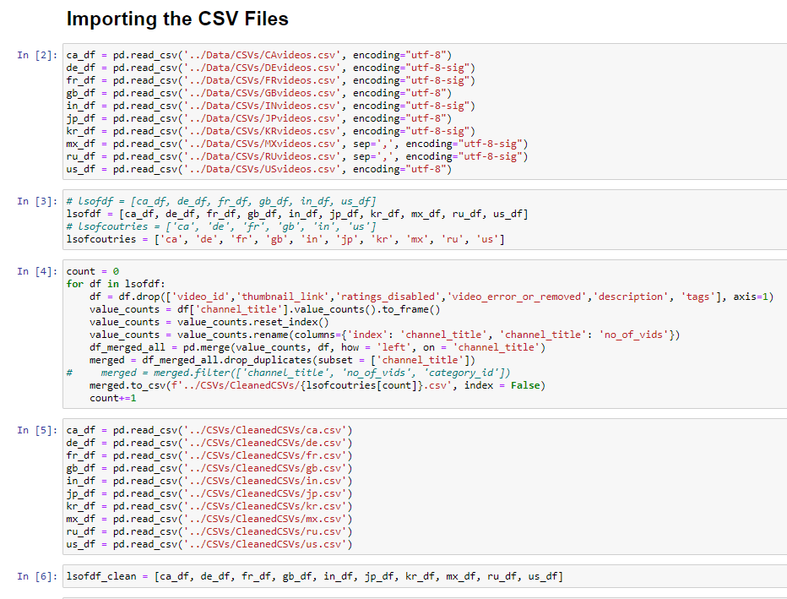

Slide 3
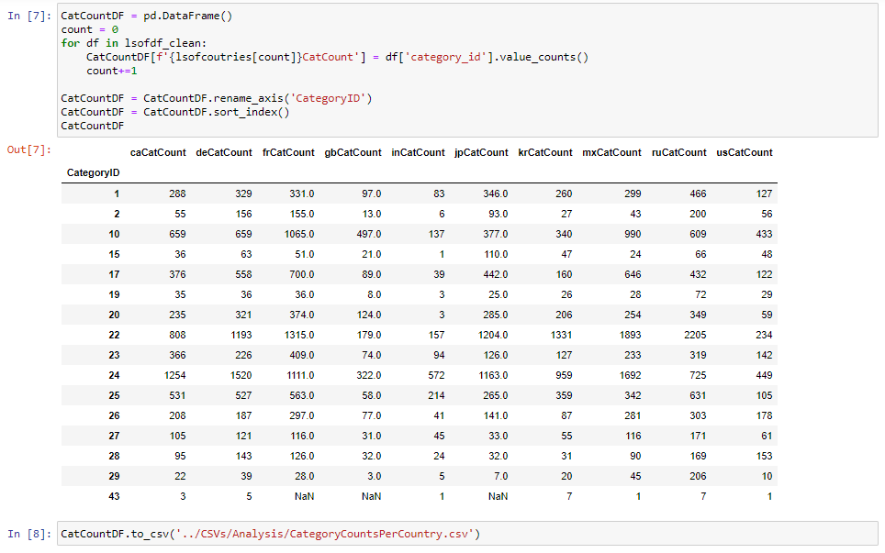

Slide 4
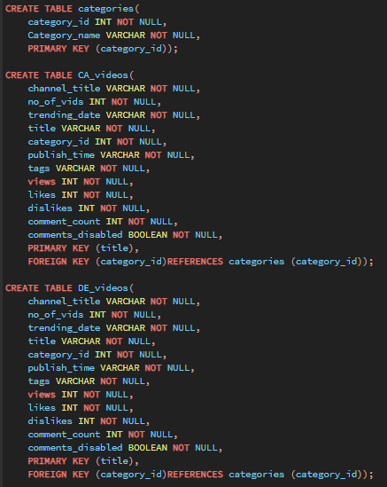

Slide 5
